Slide 1
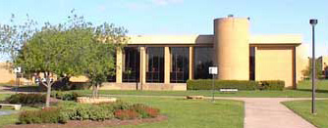
TCC Proposal
By: Benjamin Zimmerman, Collin Swanson, Uriel Martinez

Slide 2
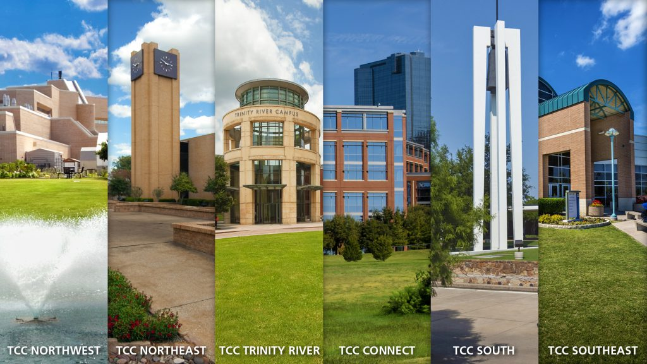
Purpose
Our purpose was to do research as to how to make resources at the TCC Northeast campus more accessible to students for their academic work.

Slide 3
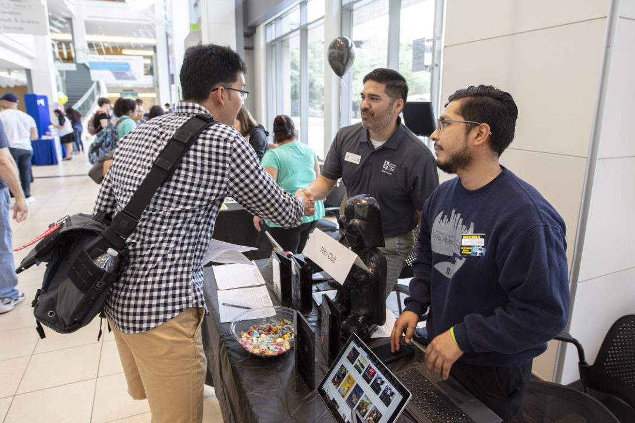
Personal Experience, Qualifications, and Why?
As TCC students, we find ourselves in a great position for this, as we have firsthand experience in this matter. We understand that the Northeast campus provides the resources that it can to students; however, finding those resources online can be quite tedious and difficult to access like submitting your work to the writing center. Frankly, if the accessibility of the resources isn’t there, students will not bother to find those resources or lose interest in finding them.

Slide 4
Task 1: Research for the Benefits of Accessing Resources for Education
We found that students who have easier access to their resources boost their interest in the topic of research (Newpath Learning).
The studies clearly show evidence that having easier access to resources keeps students engaged which is what colleges want.
From our findings, we found that universities place roughly $20 million dollars on facilities that provide resources to students (Top Universities). This does include the writing center, and the online portion of the student resources.

Slide 5

Task 2: Interview With the Director of the TCC Northeast Writing Center.
How do you feel about the quality of access to the writing center?
Would making a canvas tile for the writing center be an option that the center is willing to do?
Will creating a canvas tile dedicated for the writing center be beneficial for TCC and TCC students?

Slide 6

Task 3: Create a Survey, Get it Out There!
We conducted a survey to ask TCC students at the Northeast campus the following:
How easy is it to access student resources such as the writing center and etc…
Would you prefer a better way for it to be organized?
Would having a canvas tile for student resources on canvas be a consideration?

Slide 7
Survey Cont.
Regarding the accessibility of student resources, we ran a survey for when students want the tutoring centers to be open on weekends. Currently, tutoring centers at TCC are only open until 5 PM and 4 PM on Friday and Saturday, respectively.
We wanted to investigate if this matched student demand, or if resources could be allocated better.

Slide 8

​​Task 4: Analyze Our survey, Draw Conclusions
We met together to discuss our findings with each other, noted our finding, and summarize the survey responses. We found a correlation to the answers given to us from the TCC students on the Northeast campus.

Slide 9

Interview
Dr. Parish liked Canvas Tile idea
Wasn’t feasible
Agreed renovations was needed

Slide 10
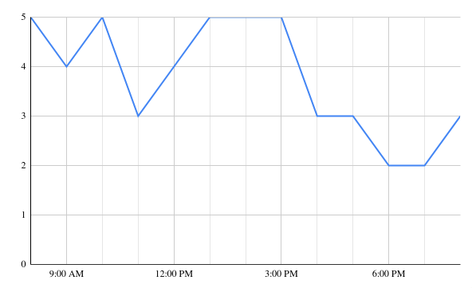
This graph indicates when students want tutoring centers open–aside from a lunch break, the data roughly matches the current hours of the tutoring center.
However, there’s a late spike after dinner which has potential.

Slide 11
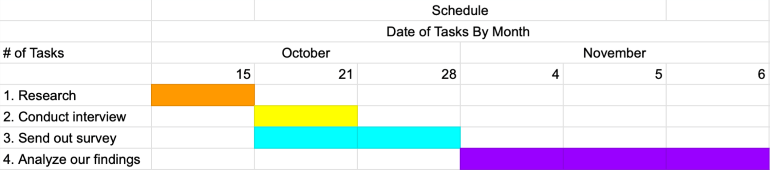
Schedule
The Gantt chart below shows our task schedule:

Slide 12
Qualifications
Students that have experienced what life is like at the TCC centers
Collected data from surveys about people’s feelings about the centers
Interviewed the head of the Writing center about the state the centers are in at the current moment

Slide 13
Challenges & Successes
Challenges
  Small sample size for the survey
  Time management
  Preparation
Successes
  The survey itself went smoothly and its data could be processed fairly easily
  Collaboration
  Completed all task

Slide 14
Works Cited
“5 Ways Open Educational Resources Can Help Students Succeed This Fall.”, New England Board of Higher Education. New England Board of Higher Education, 21 Sept. 2020, nebhe.org/journal/5-ways-open-educational-resources-can-help-students-succeed-this-fal.
NewPath Learning. “What Makes Supplemental Educational Resources Valuable to Students?” What Makes Supplemental Educational Resources Valuable to Students?, 11 Nov. 2021, www.newpathlearning.com/the-latest-news/what-makes-supplemental-educational-resources-valuable-to-students.
Parrish, Elizabeth. Personal Interview. 23 Oct. 2024
Top Universities. “University Budgets: Where Your Fees Go.”, University Budgets: Where Your Fees Go., 5 Aug. 2024, www.topuniversities.com/student-info/student-finance/university-budgets-where-your-fees-go.
Zimmerman, Ben, et al. Students View of Resource Accessibility. 21 Oct. 2024

Slide 15
Works Cited Cont.
NewPath Learning. “What Makes Supplemental Educational Resources Valuable to Students?” What Makes Supplemental Educational Resources Valuable to Students?, 11 Nov. 2021, www.newpathlearning.com/the-latest-news/what-makes-supplemental-educational-resources-valuable-to-students.‌

